Slide 1

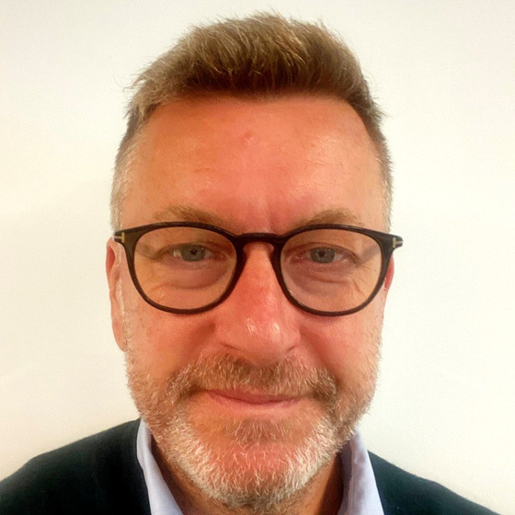
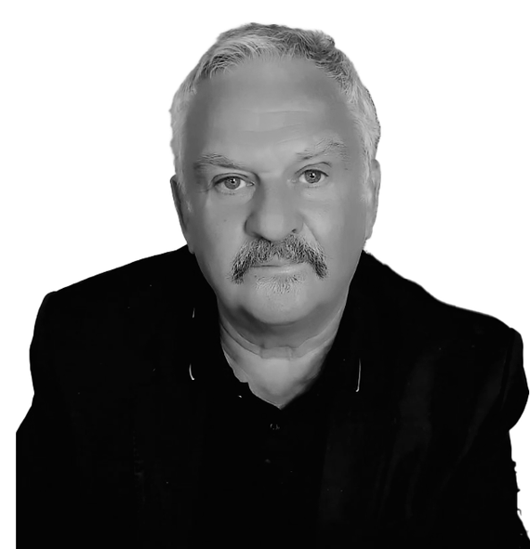
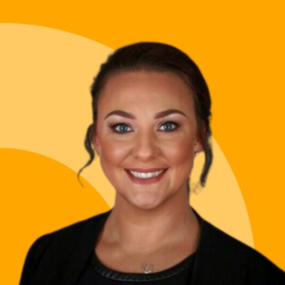

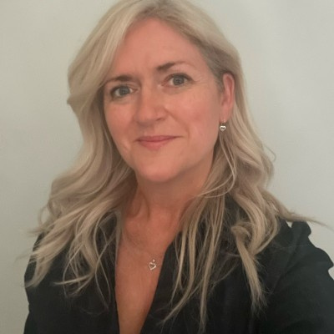
SPEAKER LINEUP
Stephen Ward,
CLC
Richard Snape, Davitt Jones Bould
Welcome to the Conveyancing & Residential Property Conference 2026
Natalie Moore, AConveyancing
DR Roger Holdom, HMLR
Presented by
Datalaw
Tracy Thompson, TT Associates

Slide 2




WHO WE ARE
Built on CPD. Now training the next generation.
1998
Today
Now
A CPD company, founded in Liverpool
One of the largest legal CPD libraries in the UK
A DfE-funded apprenticeship provider
Datalaw was established to deliver high-quality, SRA-accredited legal CPD online to legal professionals nationally and internationally. Nearly three decades on, we are still a Liverpool business.
More than 300 hours of live and recorded webinar training across every major practice area, delivered by leading practitioners — and trusted by over 27,000 solicitors.
We now deliver legal apprenticeships from Level 3 Paralegal upwards — including Conveyancing Technician, Licensed Conveyancer, Chartered Legal Executive and Solicitor.
CPD is still the core of everything we offer.
27,000+
Every apprenticeship we deliver sits on top of the same training engine — which is why our apprentices learn from the people who lecture to the profession.
solicitors trained
Notes:
SLIDE 2 — ABOUT DATALAW
A very quick word on who we are, because it explains why we put a day like this on in the first place.
Datalaw started life in 1998 as a CPD company, here in Liverpool. The whole reason we were set up was to get high-quality, SRA-accredited legal training to solicitors online, at a time when that meant sitting in a room in a hotel for a day. We are still a Liverpool business, and we are still doing exactly that.
Today we have one of the largest legal CPD libraries in the country with 000`s of hours of live and recorded training, across every major practice area, delivered by practitioners and trainers of the calibre you'll hear from this morning. Over 27,000 solicitors have trained with us.
And then, about 8 years ago, we moved into apprenticeships. We deliver Data and legal apprenticeships from Level 3 Paralegal all the way up to Conveyancing Technician, Licensed Conveyancer, Chartered Legal Executive and the Solicitor apprenticeship.
But here's the point I'd make, and it's the reason I'm comfortable standing here: CPD is not something we did before apprenticeships. CPD is the core of the proposition. Every apprenticeship we run sits on top of that same training engine. Our apprentices don't get a watered-down curriculum built for apprentices they learn from the same people who lecture to the profession. That's the difference, and you'll see it in the room today.

Slide 3


YOUR CHAIR FOR TODAY
PC
What I do at Datalaw
Working with law firms to build apprenticeship routes into their teams
Helping firms use the levy — and levy transfer — to fund legal training
Growing our conveyancing and residential property apprenticeship provision
Phil Cass
Head of Apprenticeship Business Development
Datalaw
I'll be keeping us to time, introducing each of our speakers and closing the day at around 3.10pm.
Come and find me today
Recruiting or upskilling conveyancers — and how an apprenticeship fits
The Level 6 Licensed Conveyancer route and our December 2026 cohort
Whether apprenticeship funding could cover training you already pay for
TODAY AT A GLANCE
7 sessions · Comfort break 11.00 · Lunch 1.00 · Close 3.10
Notes:
SLIDE 3 — INTRODUCING MYSELF
Very briefly, so you know who's keeping you to time today.
I'm Phil Cass, Head of Apprenticeship Business Development at Datalaw. My job, in plain terms, is to work with law firms on how apprenticeships can be used to bring people into the profession and to develop the people already sitting in your teams, including how firms make use of the apprenticeship levy, and levy transfer for the smaller firms who don't pay it.
I'm chairing today. That means I'll introduce each speaker, keep us roughly to time, and I will be gently keeping us to time, because we've got a lot to get through, and I'll close the day at around ten past three.
One ask: please do come and grab me in the breaks. If you are recruiting, if you are struggling to find qualified conveyancers, or if you're paying for training that apprenticeship funding could be covering, that is exactly the conversation I'd like to have with you today. I'll be around all day, and there's a Datalaw team here too.
Now, before our first speaker, indulge me for two minutes on one specific thing, because it's genuinely relevant to everybody in this room.

Slide 4






BEFORE WE BEGIN
Housekeeping
Fire alarm
Comfort break — 11.00 to 11.30
Lunch — 1.00 to 1.45
There is no planned fire alarm test or drill today. If the alarm sounds, please treat it as real — follow venue staff, leave by the nearest exit and do not use the lifts.
A full half hour, with refreshments provided. Please be back in your seats for 11.30 so we can start on time.
A Gino's buffet lunch is provided, with time for networking. Back in the room for 1.45 for HM Land Registry.
Finish — around 3.10pm
Questions
The room & your phone
We close with a summary and thanks at 3.05, finishing at approximately 3.10pm. The room is ours until 5pm if you'd like to stay and network.
Questions are taken at the end of each session. If we run short of time, every speaker is happy to be approached in the breaks.
Headline 2 & 3 at INNSiDE by Meliá, Old Hall Street, Liverpool. Facilities are just outside. Please switch phones to silent — and if you must take a call, do slip out.
Notes:
SLIDE 4 — HOUSEKEEPING
Just the practical bits, and then we're straight into it.
FIRE ALARM. There is no planned fire alarm test and no planned drill today. So if you hear the alarm, please treat it as the real thing. Follow the venue staff, leave by the nearest fire exit, they're marked, and there's one at the back of the room, don't use the lifts, and we'll assemble at the point the hotel directs us to. Please don't stop to collect belongings.
BREAKS. We have a full comfort break from 11.00 to 11.30, with refreshments provided. Lunch is from 1.00 to 1.45, and it's a Gino's buffet.. There's time built in for networking either side of it. Both times, please do get back in the room promptly, because our afternoon is tight.
FINISH TIME. We close with a summary and thanks at 3.05 and we'll be finished at around ten past three. If you want to carry on the conversation afterwards.
QUESTIONS. We'll take questions at the end of each session where time allows. If we don't get to yours, or if you'd rather ask it one to one, every one of our speakers has said they're happy to be approached during the breaks. Please do, access is half the value of being in the room.
Please put your phones on silent, and if you do need to take a call, just slip out quietly, nobody minds.
That's the admin done. Let's get started.

Slide 5

9.40 – 9.45 · BEFORE OUR FIRST SPEAKER
Licensed Conveyancer or
Licensed Probate Practitioner
The Level 6 apprenticeship — standard ST1311, Institute for Apprenticeships / Skills England
3
Level 6
36
£18,000
training providers
in all of England
degree equivalent,
regulated by the CLC
months typical duration,
plus 3-month assessment
maximum funding
per apprentice
We are one of only three
Set dates — not a rolling start
Datalaw is one of just three providers on the national register approved to deliver this apprenticeship — alongside Access Law Online and Total People.
Unlike the competition, our cohorts run to fixed start dates, so apprentices learn together rather than alone. Our first session is December 2026.
Register your interest today at datalaw.org/apprenticeships
Entry route: Level 4 Conveyancing Technician
Notes:
SLIDE 5 — THE LEVEL 6 APPRENTICESHIP
Two minutes on this, and then I promise we get to the actual conference.
Most people in this room will know it as "the conveyancing apprenticeship". Its proper title, the one the Institute for Apprenticeships, now Skills England, gives it is the Licensed Conveyancer or Licensed Probate Practitioner apprenticeship at Level 6. Level 6 is degree equivalent. It is aligned with and regulated by the Council for Licensed Conveyancers and Stephen Ward from the CLC is our very next speaker, so that's a neat handover.
In practical terms: it's a 36-month programme, typically, plus a three-month end-point assessment period, and there is up to eighteen thousand pounds of funding available per apprentice. The apprentice comes out with the CLC Level 6 Diploma in Conveyancing Law
Now here's the bit I want you to take away. Look at the first number on that slide. Three. There are three training providers in the whole of England approved to deliver this apprenticeship. That's it. This is not a crowded market. For an occupation that every firm in this room depends on, the entire national training capacity sits with three organisations.
And what makes us different from the other two is on the right-hand side: set dates. Ours is not a roll-on, roll-off programme where an apprentice enrols whenever and studies on their own. Our cohorts have fixed start dates, which means your apprentice learns alongside a group, at the same point in the material, with the same tutor. Anyone who has put someone through a distance-learning qualification knows exactly why that matters for completion rates.
Our first session is December 2026. So if you are thinking about this at all for next year, now is the moment.
If you'd like to register an interest, go to datalaw.org forward slash apprenticeships — or, far easier, just come and find me at the break, I'm here all day.
And one last thing: if Level 6 feels like a big first step, the entry route is the Level 4 Conveyancing Technician apprenticeship, which we also deliver, and which feeds straight into the Level 6. So there's a path in at whatever level your people are at today.
Right. Let's meet our first speaker.

Slide 6
UP NEXT · SESSION 1 OF 7
SW
Stephen Ward
9.45 – 10.15
Director of Strategy & External Relations
Council for Licensed Conveyancers
The State of the Sector: A CLC Perspective
Leads on the development and delivery of the CLC's strategy as the specialist regulator for conveyancing and probate lawyers.
Background spanning the civil service, political campaigning and business strategy in the private sector.
Previously Director of Communications and Corporate Social Responsibility at the Law Society.
IN THIS SESSION
A timely update on the current conveyancing landscape
Regulatory priorities from the CLC's perspective
Emerging challenges — and the opportunities they open up
A clearer view of the issues shaping the sector's future
Session 1 of 7 · 9.45 – 10.15 · Questions at the end of the session
Conveyancing & Residential Property Conference 2026
Notes:
SLIDE 6 — INTRODUCING STEPHEN WARD (9.45)
Our first speaker this morning comes to us from the Council for licensed Conveyancers.
Stephen Ward is Director of Strategy and External Relations at the Council for Licensed Conveyancers the specialist regulator for conveyancing and probate lawyers, and the body that licenses the profession many of you work in. Stephen leads on the development and delivery of the CLC's strategy, so he has as clear a view as anybody of where this sector is heading.
He comes at it from an unusual and, I think, very useful angle: his background spans the civil service, political campaigning, and business strategy in the private sector — and before the CLC he was Director of Communications and Corporate Social Responsibility at the Law Society. So he knows the profession from both sides of the regulatory line.
This morning Stephen is going to give us "The State of the Sector: A CLC Perspective". He'll set out where the conveyancing landscape actually is right now, what the CLC's regulatory priorities are, and the challenges — and opportunities — coming down the track. It's the ideal session to open with, because it gives us the frame for everything else we'll hear today.
Stephen has thirty minutes and we'll take questions at the end.
Please join me in welcoming Stephen Ward.

Slide 7
The State of the Sector:
A CLC Perspective
Datalaw Session 2026​
Stephen Ward
Council for Licensed Conveyancers

Slide 8
THANK YOU
Thank you, Stephen
A regulator's-eye view of where the sector is heading — and a useful frame for everything that follows today.
If you have a question we didn't get to, please do go and grab them over the break — every speaker today has said they're happy to be approached.
COMING UP NEXT
Richard Snape
10.15 – 11.00
Leasehold Reform and Commonhold · Davitt Jones Bould
Notes:
SLIDE 7 — THANK YOU STEPHEN (10.15)
Stephen, thank you — that was a fascinating session, and exactly the right place to start.
As I said, if there's a question we didn't get to, or something you'd rather raise one to one, Stephen is with us this morning, so please do go and find him at the break. I'd encourage you to — you don't often get the regulator in the room and willing to talk.
Ladies and gentlemen, please show your appreciation once more for Stephen Ward.
[APPLAUSE — then move on]
Now. We move from the regulatory picture to the law itself, and to what is probably the biggest change to leasehold in any of our working lifetimes.

Slide 9
UP NEXT · SESSION 2 OF 7
RS
Richard Snape
10.15 – 11.00
Head of Legal Training
Davitt Jones Bould
Leasehold Reform and Commonhold
IN THIS SESSION
One of the country's best-known property law trainers, leading the DJB training programme since 2002.
Former Head of Property Law at the University of the West of England and a visiting lecturer at Bristol University.
Published in The Conveyancer and the New Law Journal, and a regular lecturer for local law societies and HM Land Registry.
The Leasehold and Freehold Reform Act 2024 and its impact on leasehold houses
Proposed reforms under the Commonhold and Leasehold Reform Bill 2026
Service, administration and estate management charges; lease extensions and judicial review
Abolition of forfeiture, ground rent caps, and the proposed ban on new leasehold flats
Converting existing developments to commonhold and the governance of Commonhold Associations
Session 2 of 7 · 10.15 – 11.00 · Questions at the end of the session
Conveyancing & Residential Property Conference 2026
Notes:
SLIDE 8 — INTRODUCING RICHARD SNAPE, SESSION ONE (10.15)
Our next speaker will need no introduction to many of you, but he's getting one anyway.
Richard Snape is Head of Legal Training at Davitt Jones Bould, and has led their training programme since 2002. He is, without much argument, one of the best-known property law trainers in the country. Before DJB he was Head of Property Law at the University of the West of England, he has been a visiting lecturer at Bristol University's law faculty, and he's published in The Conveyancer and the New Law Journal. He lectures for local law societies and for HM Land Registry up and down the country — so there's a fair chance some of you have sat in one of his sessions before.
This morning he's taking on Leasehold Reform and Commonhold — and he's got forty-five minutes for what is a genuinely enormous subject.
Richard will cover the Leasehold and Freehold Reform Act 2024 and what it means for leasehold houses; the proposed reforms under the Commonhold and Leasehold Reform Bill 2026; the changes to service charges, administration charges and estate management charges; reform of lease extensions and judicial review; the proposed abolition of forfeiture and the introduction of ground rent caps. And then the direction of travel — the proposed ban on new leasehold flats, converting existing developments to commonhold, and how Commonhold Associations will actually be governed.
If you act on leasehold at all, this is the session to have your notepad out for.
Please welcome Richard Snape.

Slide 10
Leasehold Reform & Commonhold
Datalaw Session 2026​
Richard Snape
Davitt Jones Bould

Slide 11
THANK YOU
Thank you, Richard
The most significant change to leasehold dwellings in living memory — set out in a way we can actually take back to the desk.
If you have a question we didn't get to, please do go and grab them over the break — every speaker today has said they're happy to be approached.
COMING UP NEXT
Comfort break
11.00 – 11.30
Refreshments provided · Please be seated again for 11.30
Notes:
SLIDE 9 — THANK YOU RICHARD (11.00)
Richard, thank you — a fascinating session, and I think that's the clearest anyone has made that subject for me.
The good news is Richard is back with us at half past eleven for the case law update, so if you have a question burning away, you have two chances to ask it — and he's around over the break as well.
Please thank Richard Snape.
[APPLAUSE]
HOUSEKEEPING FOR THE BREAK:
That takes us to our comfort break. It's a full half hour — refreshments are provided just outside. Facilities are through the door and to the [CHECK ON ARRIVAL].
Please be back in your seats for half past eleven, because Richard is straight back on and we've a full afternoon after that.
And do use the break properly — have a conversation with someone you haven't met. That's half of why we run these days. I'll be by the [Datalaw stand / back of the room] if anyone wants to talk apprenticeships.
See you at 11.30.

Slide 12
11.00 – 11.30
Comfort break
Refreshments are provided just outside the room.
Please do use the time to meet somebody new.
Back in the room for 11.30
Next: Conveyancing Case Law Update — Richard Snape
Notes:
SLIDE 10 — COMFORT BREAK HOLDING SLIDE (11.00 – 11.30)
Leave this slide up on the screen through the break.
TO SAY BEFORE YOU STEP DOWN:
"Refreshments are just outside. Please be back in your seats for half past eleven — Richard is straight back on with the case law update and we need the full forty-five minutes."

Slide 13
UP NEXT · SESSION 3 OF 7
RS
Richard Snape
11.30 – 12.15
Head of Legal Training
Davitt Jones Bould
Conveyancing Case Law Update
IN THIS SESSION
Richard returns for a second session, this time on the cases that are reshaping day-to-day conveyancing practice.
Head of Legal Training at Davitt Jones Bould and a nationally renowned speaker on property law.
Former Head of Property Law at the University of the West of England.
Recent judicial guidance on the validity and use of email signatures
Boundary agreements and the determination of property boundaries
Rights relating to car parking
Litigation arising from the Building Safety Act
Important recent decisions on adverse possession
Session 3 of 7 · 11.30 – 12.15 · Questions at the end of the session
Conveyancing & Residential Property Conference 2026
Notes:
SLIDE 11 — WELCOME BACK & RICHARD, SESSION TWO (11.30)
Welcome back everybody, I hope you got a cup of tea. If you could take your seats, we'll get going.
Richard Snape is back with us — Head of Legal Training at Davitt Jones Bould, former Head of Property Law at the University of the West of England, and as you've just seen, one of the country's most respected property law trainers.
This time he's on the Conveyancing Case Law Update: the recent decisions that are actually shaping how we work, and what they mean in practice.
Richard is going to cover recent judicial guidance on the validity and use of email signatures — which I suspect will make a few people in this room sit up; boundary agreements and how boundaries get determined; rights relating to car parking; the litigation now coming through from the Building Safety Act; and some important recent decisions on adverse possession.
This is the risk management session of the morning. If you want to know what's going to land on your desk as a claim in two years' time, it's probably on this list.
Richard — over to you.

Slide 14
Conveyancing Case
Law Update
Datalaw Session 2026​
Richard Snape
Davitt Jones Bould

Slide 15
THANK YOU
Thank you, Richard
A lot of practical risk management packed into forty-five minutes — and plenty to check our precedents against.
If you have a question we didn't get to, please do go and grab them over the break — every speaker today has said they're happy to be approached.
COMING UP NEXT
Natalie Moore
12.15 – 12.55
Beyond the Legal Work: Improving the Customer Journey · Aconveyancing
Notes:
SLIDE 12 — THANK YOU RICHARD (12.15)
Richard, thank you once again — two sessions, back to back, and both of them full of things we can take straight back to the office.
Richard has given us his whole morning, so please do thank him properly.
[APPLAUSE]
If you'd like to follow anything up with Richard, he's happy to be approached over lunch — and Davitt Jones Bould run a full CPD programme of their own, so it's worth a conversation.
Now we change gear. We've spent the morning on the law: the regulation, the reform, the case law. Our next speaker wants to talk about the bit that clients actually judge us on.

Slide 16
UP NEXT · SESSION 4 OF 7
NM
Natalie Moore
12.15 – 12.55
Founder & Legal Director
Aconveyancing
Beyond the Legal Work: Improving the Customer Journey in Home Moving
Almost twenty years in conveyancing; qualified as a Licensed Conveyancer through the CLC route.
Founded Aconveyancing in 2017; the firm now operates from Tamworth and Daventry and was among the first law firms to trial a four-day week.
Named Managing Partner of the Year at the Modern Law Conveyancing Awards.
IN THIS SESSION
Why conveyancing is judged on experience, not just the legal work
Communication, trust and managing client expectations
Working with estate agents, brokers and other professionals
Real-life examples of changes that reduce complaints and lift satisfaction
Delivering a better journey without compromising compliance or risk management
Session 4 of 7 · 12.15 – 12.55 · Questions at the end of the session
Conveyancing & Residential Property Conference 2026
Notes:
SLIDE 13 — INTRODUCING NATALIE MOORE (12.15)
Our next speaker comes to us from the other side of the desk — running a conveyancing firm, day in, day out.
Natalie Moore is the founder and Legal Director of Aconveyancing. She has been in conveyancing for the best part of twenty years, and she qualified as a Licensed Conveyancer through the CLC route — the very route Stephen Ward's organisation regulates, and the route our Level 6 apprenticeship leads to, so she is living proof of where that path goes.
She founded Aconveyancing in 2017. The firm now operates from Tamworth and Daventry, and it was one of the first law firms in the country to trial a four-day working week. Natalie was named Managing Partner of the Year at the Modern Law Conveyancing Awards.
Her session is "Beyond the Legal Work: Improving the Customer Journey in Home Moving", and the premise is one that I think will resonate with everyone here: conveyancing is very rarely judged on the quality of the legal work. It's judged on how the process felt.
Natalie will look at communication, building trust and managing expectations; working more collaboratively with estate agents, brokers and other professionals; and she'll share real examples from her own practice of changes that reduced complaints and improved client satisfaction — all without compromising legal compliance or risk management.
Please welcome Natalie Moore.
[NOTE: the firm is "Aconveyancing" — one word. Her board title is Legal Director; she also describes herself as founder. "Founder and Legal Director" covers it.]

Slide 17
Beyond the Legal Work: Improving the Customer Journey in Home Moving
Natalie Moore
Datalaw Session 2026​
AConveyancing

Slide 18


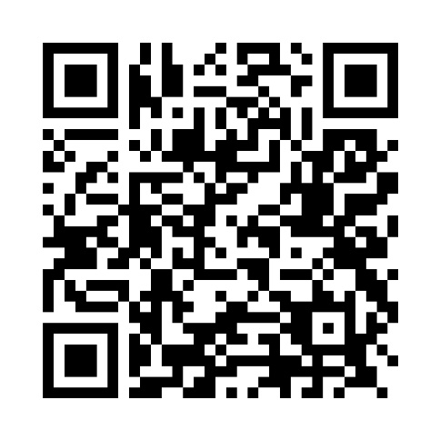

About Me
Natalie Moore
20+
HOLP
Founder
years in property law
leadership + live matters
award-winning practice
Practical insight from both sides of the client experience: running the practice and handling matters.
nmoore@aconveyancing.com
www.aconveyancing.com

Slide 19

Overview
In this session we will be covering:
The Client Journey
🤝 Onboard with confidence
👤 Know your client
🏠 Know the property
📄 Brief & hand over
💬 Communicate proactively
🛡️ Avoid/Resolve complaints
⭐ Earn great reviews
🔋 Avoid burnout and Enjoy conveyancing

Slide 20
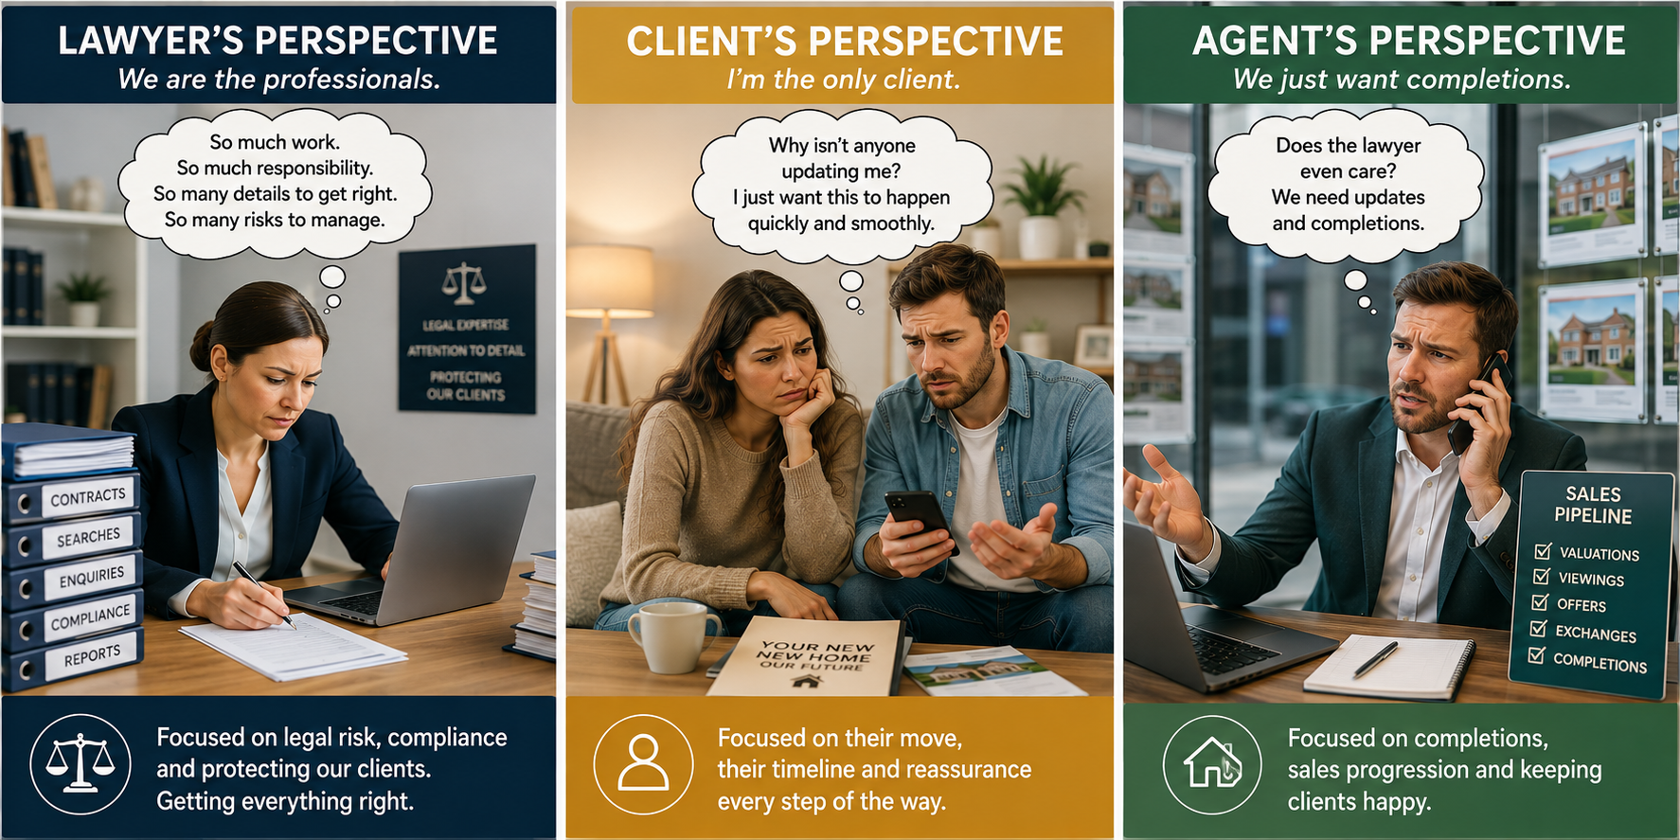
The Client Journey

Slide 21

WHY THIS MATTERS
Conveyancing complaint volumes
The pressure points are concentrated and visible
7,203
30%
78%
new complaints
residential conveyancing
evidence of poor service
Top complaint themes
Poor communication
24%
Delay / failure to progress
23%
Failure to advise
19%

Slide 22


ACONVEYANCING
A client journey
designed around
clarity and choice
Digital where it helps. Human when it matters.

Slide 23

THE WIDER REALITY
A trusted profession under strain
Longer transactions, fragile chains and stretched teams
54%
120
1 in 3
trust lawyers**
days average***
sales fall through
60%
59%
79%
longer than 2007*
poor wellbeing
work beyond hours
Question: is this an attractive career?
* Ipsos Veracity Index
**Gov consultation 2026
***Gov.uk
Notes:
Lack of experienced / qualified lawyers
Level 4 apprenticeship in conveyancing represented 0.25% of all achievements 24 /25****
59% legal professionals report poor mental wellbeing, 79% regularly work beyond their contracted hours. Conveyancer report VERY high level of workplace stress

Slide 24
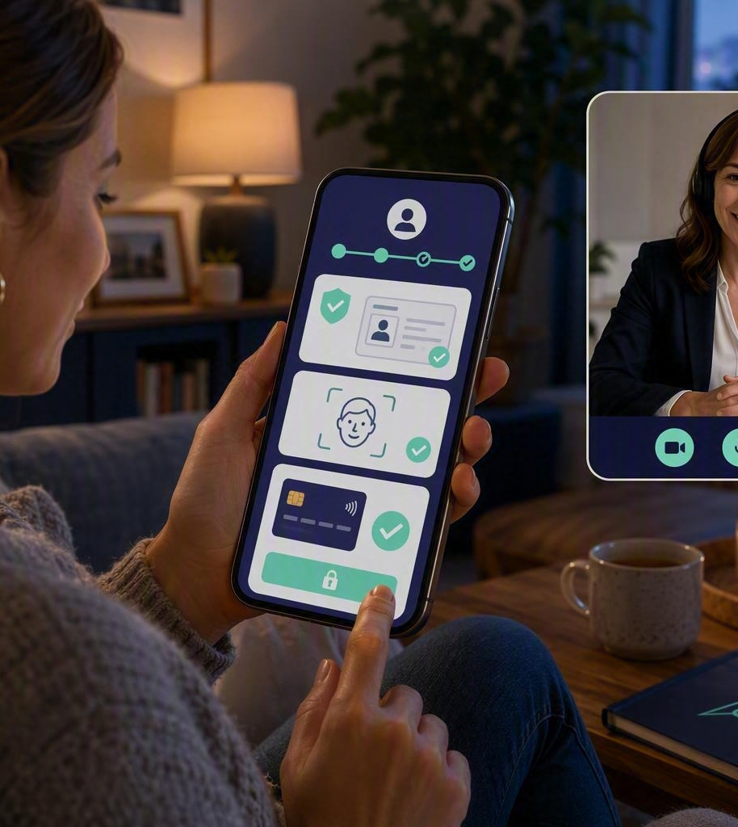
KYC
Onboard with confidence
Capture once. Offer choice. Start with the person, not just the file.
Online and mobile-first, with opening hours to 7pm
AI Anna complements customer service
ID and payment can be completed online
KEY:
Not just legal…
Capture communication preferences, holidays, wants and needs
Pre-populate information already gathered
Save everything to the central database

Slide 25
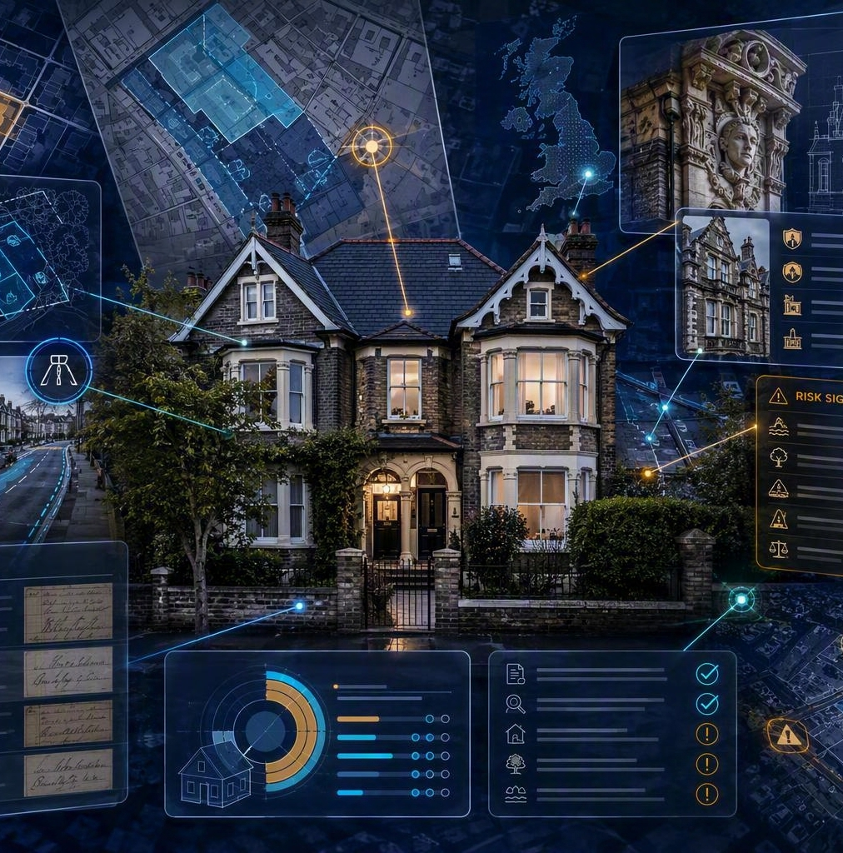
KYP
Know the property before work begins
Turn property data into early visibility and action
300
1
EARLY
data points
complexity score
document actions
Planning and road adoption
Listed building indicators
Property sale history
Cross-referenced risk and complexity
Actions to chase missing documents

Slide 26

THE HANDOVER
Brief the lawyer. Reassure the client.
The quality of the first meeting is designed before it starts.
KYC, KYP, ID and proof of funds prepared first
Online meeting link sent automatically
Dedicated Lawyer diaries accessible online
Briefing document structures the conversation
Prepared client + prepared lawyer = confident start

Slide 27

THE PAYOFF
Set every file up to succeed
A better first impression reduces friction later
✓
CONTROL
Lawyers start informed
✓
ACCURACY
Information is checked
✓
CONFIDENCE
Clients know what happens next
✓
TRUST
A relationship starts early
✓
CAPACITY
Fewer avoidable enquiries

Slide 28

KEYS TO SUCCESS
Make collaboration visible
Clarify who does what, when and how updates happen
OWNERSHIP
Who does what and when
CHANNELS
Proactive + automated
EXPECTATIONS
The 80:20 rule
EDUCATION
Bring stakeholders with you
PROGRESSORS
Use the resource, do not fight it

Slide 29
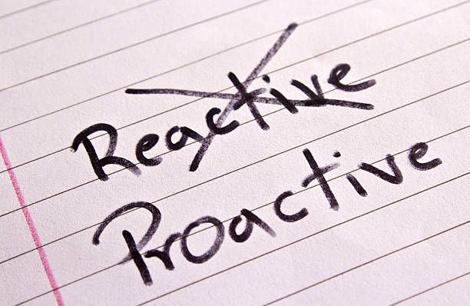
COMPLAINTS
Prevention starts before dissatisfaction
The same three themes point to where safeguards matter most
24%
23%
19%
poor communication
delay / no progress
failure to advise
Inform early. Explain delays. Record advice.
Avoidance is not the key. Visibility and ownership are.
*LeO latest Report 24/25

Slide 30
DISCUSSION
Where would you intervene first?
01
02
03
COMMUNICATION
PROGRESS
ADVICE

Slide 31

CONCLUSION
A better journey
benefits everyone.
Less stress and stronger wellbeing
A more attractive career
Better professional reputation
Shorter, smoother transactions
Natalie Moore
Legal Director, Aconveyancing
Collaboration turns good intentions into a consistent client experience.
nmoore@aconveyancing.com
www.aconveyancing.com

Slide 32
THANK YOU
Thank you, Natalie
A refreshingly practical reminder that the client experience and good legal work are not in competition.
If you have a question we didn't get to, please do go and grab them over the break — every speaker today has said they're happy to be approached.
COMING UP NEXT
Phil Cass
12.55 – 1.00
Reaccreditation Training · Datalaw
Notes:
SLIDE 14 — THANK YOU NATALIE (12.55)
Natalie, thank you — a fascinating session and a really valuable change of perspective for the middle of the day.
I think the point that will stay with me is that the experience and the legal work are not in competition with each other. Natalie is here over lunch, so if you want to ask how any of that actually landed in her firm, go and ask her.
Please thank Natalie Moore.
[APPLAUSE]
Right — one very short item before we eat.

Slide 33
UP NEXT · SESSION 5 OF 7
PC
Phil Cass
12.55 – 1.00
Datalaw
CQS Reaccreditation Training
IN THIS SESSION
Phil Cass, Head of Apprenticeship Business Development at Datalaw, is chairing today and will cover this short session.
Datalaw's reaccreditation training is built around the Law Society's mandatory training requirements for CQS member firms.
A short briefing on CQS reaccreditation obligations
What your firm needs in place for reaccreditation
How Datalaw can support your CQS training requirement
Session 5 of 7 · 12.55 – 1.00 · Questions at the end of the session
Conveyancing & Residential Property Conference 2026
Notes:
SLIDE 15 — CQS Reaccreditation Training
If your firm is CQS accredited, you'll know reaccreditation comes round every year, and with it the mandatory update training.
There are two courses your whole conveyancing team must complete: Conveyancing Practice, covering the latest legal updates, emerging risks and best practice, and Risk, Compliance and Client Care, covering fraud, anti-money laundering and client care standards.
As a lot of you will know, Datalaw are now one of only 3 providers authorised by the Law Society to deliver CQS training. That means our certificates are guaranteed to be accepted on your resubmission.
We cover your entire firm, with no limit on staff numbers, for just £599 plus VAT.
And we've built a dedicated CQS Reporting tool, so your Senior Responsible Officer can assign courses, track completion and download certificates all in one place.
We will be looking to send a free trial across to all users, so please let me know if you have any questions regarding this.

Slide 34
THANK YOU
Short, but an important one to have on the radar — particularly for anyone with a reaccreditation date approaching.
If you have a question we didn't get to, please do go and grab them over the break — every speaker today has said they're happy to be approached.
COMING UP NEXT
Gino's buffet lunch
1.00 – 1.45
Lunch and networking · Back in the room for 1.45
Notes:
SLIDE 16 — THANK YOU JOE (1.00)
Joe, thank you — short and to the point, which is exactly what was needed before lunch.
If CQS reaccreditation is on your horizon, Joe is here all afternoon and it's a five minute conversation that could save you a headache later.
Please thank Joe McCormick.
[APPLAUSE]
LUNCH ANNOUNCEMENT:
And that takes us to lunch. It's a Gino's buffet, it's being served [CONFIRM LOCATION WITH VENUE — in the room / in the foyer], and we have until quarter to two.
Three things:
One — please do eat, it's included and it's good.
Two — please use the time. There are conveyancers in this room from firms of every size. Go and talk to somebody you didn't arrive with.
Three — and I mean this — please be back in your seats for 1.45. We have HM Land Registry straight after lunch and then our final session, and we want to give both of them their full time.
Enjoy your lunch. See you at quarter to two.

Slide 35
1.00 – 1.45
Lunch & networking
A Gino's buffet lunch is provided.
Please take the time to meet the people around you.
Back in the room for 1.45
Next: HM Land Registry — Dr Roger Holdom
Notes:
SLIDE 17 — LUNCH HOLDING SLIDE (1.00 – 1.45)

Slide 36
UP NEXT · SESSION 6 OF 7
RH
Dr Roger Holdom
1.45 – 2.25
Market Strategy & Customer Training Lead
HM Land Registry
HM Land Registry: Avoidable Requisitions, Customer Training and Support
Leads HM Land Registry's customer training and market strategy work, including its programme of online workshops for conveyancers.
A regular voice on post-completion quality, digital checks and application standards, writing for the HM Land Registry blog.
Speaks nationally on requisitions and on raising the quality of applications at source.
IN THIS SESSION
What the latest avoidable requisition data reveals about common application errors
The cost, delay and rework these errors create for firms and their clients
The latest requisition trends
The benefits of submitting complete and correct applications first time
Practical steps firms can take to improve application quality and reduce correspondence
Session 6 of 7 · 1.45 – 2.25 · Questions at the end of the session
Conveyancing & Residential Property Conference 2026
Notes:
SLIDE 18 — WELCOME BACK & INTRODUCING DR ROGER HOLDOM (1.45)
Welcome back everybody, I hope you enjoyed lunch. If you could take your seats, we'll press on.
Our first session of the afternoon comes from HM Land Registry, which I suspect makes it the session with the most direct effect on your working week of anything we hear today.
Dr Roger Holdom is HM Land Registry's Market Strategy and Customer Training Lead. He leads their customer training work, including their programme of online workshops for conveyancers, and he's a regular voice on post-completion quality, digital checks and application standards — he writes for the HM Land Registry blog and speaks nationally on requisitions and on getting application quality right at source.
His session is "Avoidable Requisitions, Customer Training and Support", and the operative word there is avoidable.
Roger will take us through what the latest requisition data actually reveals about the most common application errors; the real cost of those errors in delay, rework and money, both for your post-completion teams and for your clients; the latest trends; and — most usefully — the practical steps firms can take to improve application quality, save time and cut out unnecessary correspondence.
If you have a post-completion team, this is a session to take notes for them.
Please welcome Dr Roger Holdom.

Slide 37
HM Land Registry: Avoidable Requisitions, Customer Training & Support
Dr Roger Holdom
HM Land Registry
Datalaw Session 2026​

Slide 38

Helping you save money, time, and be registered faster
Up to
£19.1m
estimated annual industry cost
£5 to £30
1
£19,100,000
2
.
3

Slide 39
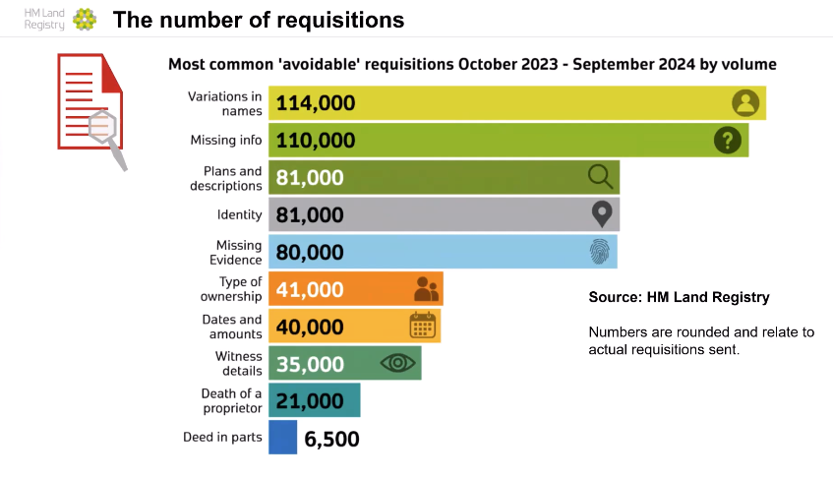

Slide 40
Listening to customers……..
Ease
Control
Consistency
Clarity
Support
Stronger
Source: Customer Heartbeat Survey Q 2025/26

Slide 41
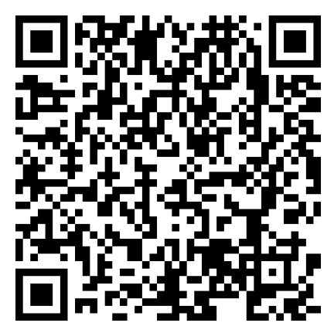
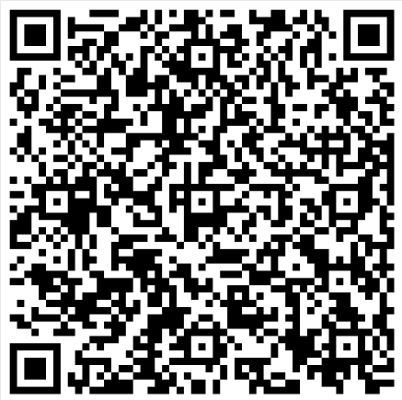
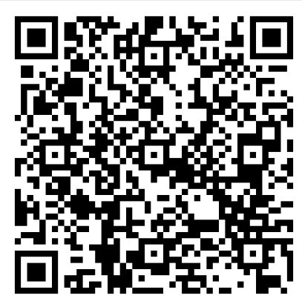
Avoidable Requisition Data
Free Customer Training Workshops and Webinars
Customer Services Centre & ‘Contact us’
Managed Services Support
Customer engagement
Support
Avoidable Requisition Data
Training Workshops
Managed Support Services

Slide 42
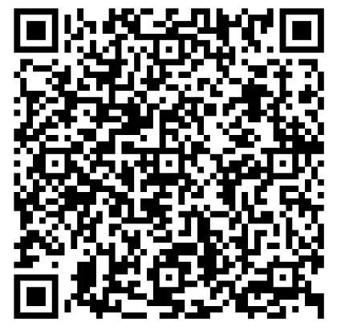
Lender data
Customer communications
Application-related correspondence emails
Clarity
Correspondence emails

Slide 43
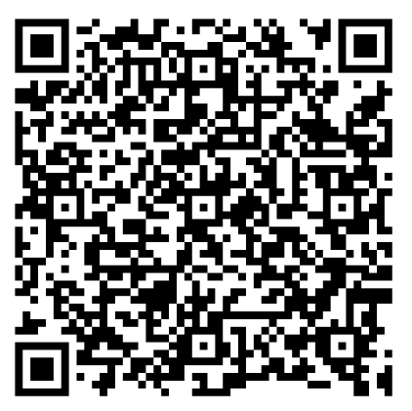
Our Land Registration Academy
Customer Charter
Complaints handling
Digital checks and validation
Consistency
Digital checks

Slide 44

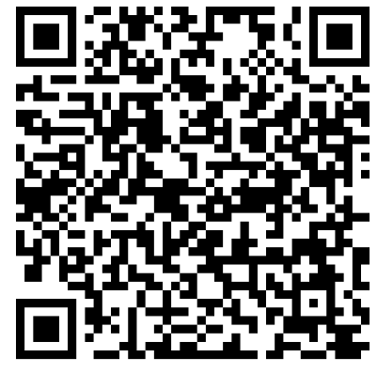
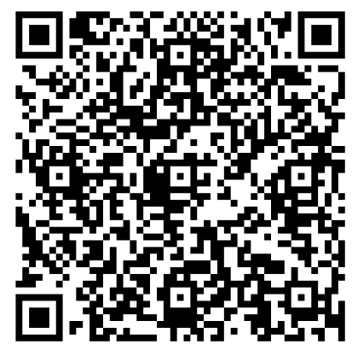
Research and surveys
Property Alerts
Sign up to HMLR GOV.UK emails
Control
Sign up to
Property Alerts
Sign up to HMLR updates
QES

Slide 45
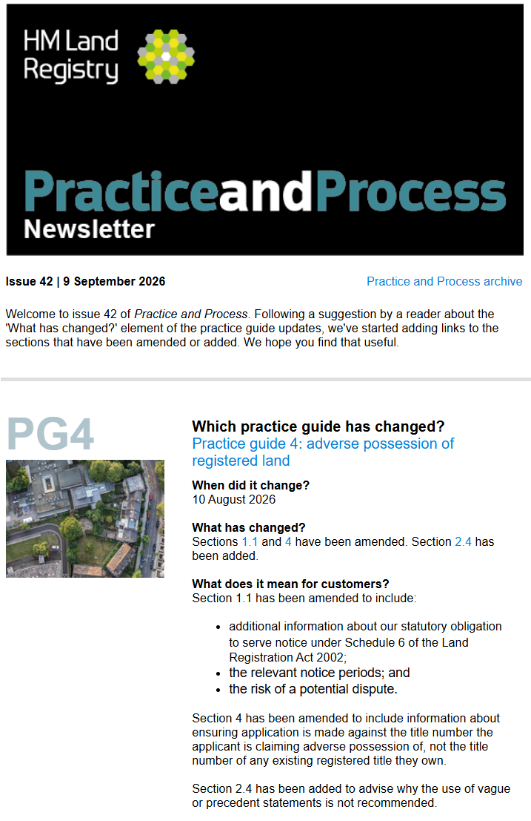
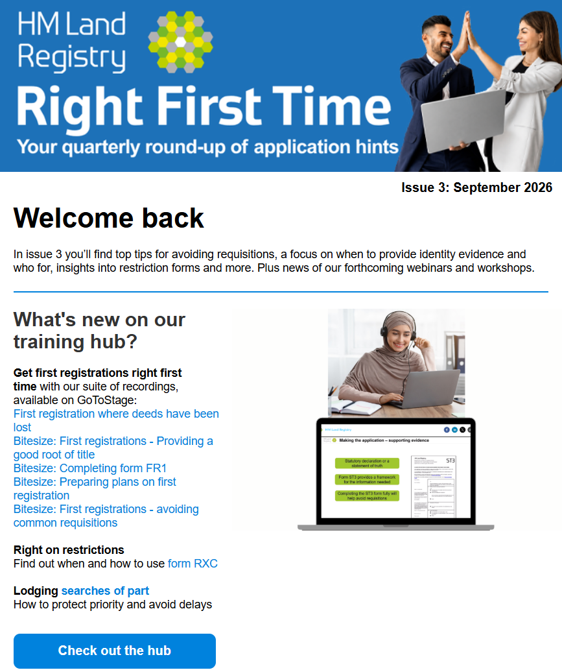
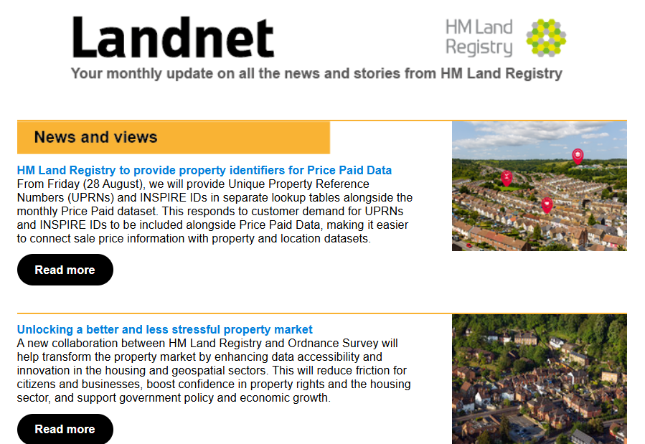
Sign up for HMLR updates

Slide 46
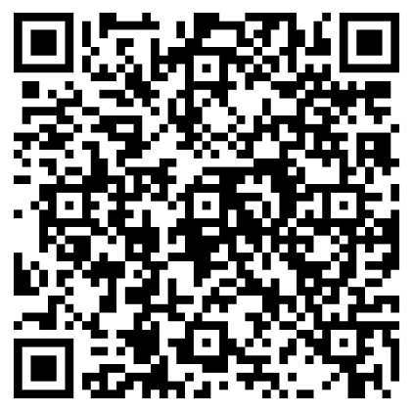
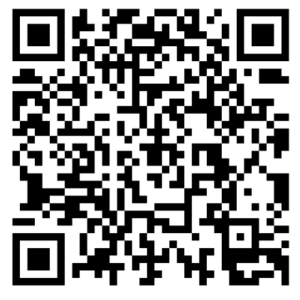
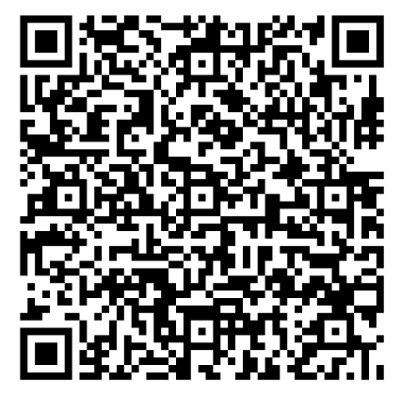
Portal ‘Reply to Requisition’
Portal View Applications
Portal business unit reporting
Ease
Opt in to
Portal Reporting
View
Applications
Portal & Business Gateway Parity

Slide 47
Continuous Improvement
Commonhold
Contractual controls
Unique Property Reference Numbers (UPRNs) and INSPIRE IDs
Qualified Electronic Signatures (QES)
Future

Slide 48
Questions and Comments

Slide 49
THANK YOU
Thank you, Roger
Hard data on where applications go wrong, and a clear set of things we can each do differently on Monday morning.
If you have a question we didn't get to, please do go and grab them over the break — every speaker today has said they're happy to be approached.
COMING UP NEXT
Tracy Thompson
2.25 – 3.05
When the Inspector Comes Calling: Defensible Conveyancing Files · Tracy Thompson Associates
Notes:
SLIDE 19 — THANK YOU ROGER (2.25)
Roger, thank you — a fascinating session
Please thank Dr Roger Holdom.
[APPLAUSE]
And that brings us to our final session of the day — and it's the one that ties the whole thing together.

Slide 50
UP NEXT · SESSION 7 OF 7
TT
Tracy Thompson
2.25 – 3.05
Risk & Compliance Consultant
Tracy Thompson Associates
When the Inspector Comes Calling: What Defensible Conveyancing Files Look Like
Law Society-accredited Lexcel Consultant and Assessor, specialising in CQS, Lexcel and anti-money laundering.
Over twenty-five years in the legal profession; qualified as a lawyer in 2008 and formerly Managing Partner of a Merseyside multi-disciplinary practice.
Formerly a member of the Law Society Lexcel Panel and a CQS Lead Assessor; now provides Regulation 21 AML independent audits to firms nationwide.
IN THIS SESSION
Practical compliance with the 2026 AML requirements
What CQS expects to see on the file
What a defensible file actually looks like when it is inspected
Common gaps that turn a good file into a finding
Session 7 of 7 · 2.25 – 3.05 · Questions at the end of the session
Conveyancing & Residential Property Conference 2026
Notes:
SLIDE 20 — INTRODUCING TRACY THOMPSON (2.25)
Our final speaker today is Tracy Thompson of Tracy Thompson Associates.
Tracy is a Law Society-accredited risk and compliance specialist — an accredited Lexcel Consultant and Lexcel Assessor — who works with firms across the country on CQS, on Lexcel and on anti-money laundering. She has over twenty-five years in the legal profession, qualified as a lawyer in 2008, and was most recently in practice as Managing Partner of a Merseyside multi-disciplinary practice, so she knows this from the inside as well as from the audit side. She has previously sat on the Law Society's Lexcel Panel and served as a CQS Lead Assessor, and she now provides Regulation 21 AML independent audits to practices nationwide.
Her session is called "When the Inspector Comes Calling: What Defensible Conveyancing Files Look Like" — which is, I think, the perfect title to end a conference on.
Tracy will cover practical compliance with the 2026 AML requirements and with CQS: what a defensible file actually looks like when somebody comes to inspect it, and the common gaps that turn a perfectly good file into a finding.
Everything we've heard today — the regulation, the reform, the case law, the client experience, the application quality — all of it ends up on a file. This is the session about whether that file will stand up.
Please welcome Tracy Thompson.
[NOTE: the schedule shows "TT Associates" — the firm is Tracy Thompson Associates. Her Lexcel Panel and CQS Lead Assessor roles are previous appointments, not current ones, so introduce them in the past tense as above.]

Slide 51
When the Inspector Comes Calling: What Defensible Conveyancing Looks Like
Tracy Thompson
Datalaw Session 2026​
Tracy Thompson Associates

Slide 52
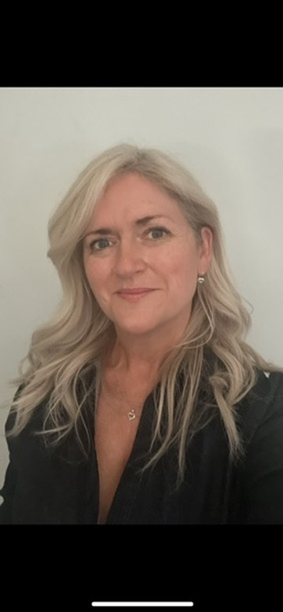
About Me
Speaker Photo
Tracy Thompson
Law Society Accredited Risk & Compliance Specialist
Lawyer
Law Society Lexcel Assessor & Consultant
Former Lexcel Panel Member
Former CQS Lead Assessor
30 years in the legal profession
@thompsontracy
tt@tracythompsonassociates.co.uk
www.tracythompsonassociates.co.uk
07702 040784

Slide 53

Overview
• 2026 AML changes and SRA sector risk signals
• The link between FWRA, PCPs and conveyancing files
• CMRA: evidencing judgement, not ticking boxes
• CDD, source of funds/wealth and client account red flags
• CQS expectations: file discipline, training and supervision
In this short session we will be covering:
Notes:
Presenter prompt
Set out the journey: regulatory updates, firm-level controls, then what that should look like on the conveyancing file.
[Sources]
- Money Laundering Regulations 2017 as amended in 2026.
- SRA Sectoral Risk Assessment, August 2026.
- CQS Core Practice Management Standards and Law Society conveyancing practice requirements.

Slide 54

• Do your files show a live risk-based approach?
• Can someone follow the AML judgement without asking the fee earner?
• Are decisions consistent with your FWRA and PCPs?
• Can supervision, escalation and training be evidenced?
The inspector’s question
The file needs to speak for itself.
Tracy Thompson Associates | AML 2026 + CQS | Property Conference
Notes:
Presenter prompt
This is the core message. A file is defensible when it explains the decision-making clearly enough to be understood later.
[Sources]
- Money Laundering Regulations 2017 as amended in 2026.
- SRA Sectoral Risk Assessment, August 2026.
- CQS Core Practice Management Standards and Law Society conveyancing practice requirements.

Slide 55
• EDD trigger refined: unusually complex or unusually large in context
• High-risk countries: mandatory EDD now focuses on FATF call-for-action jurisdictions
• Pooled client account provisions require clear risk thinking and record keeping
• Sterling thresholds replace euro thresholds
• PCPs, FWRA, matter risk assessments and training should all be refreshed
2026 AML changes: what property
teams need to notice
The key practical point: update documents and train people, not just the policy footer.
Tracy Thompson Associates | AML 2026 + CQS | Property Conference​
Notes:
Presenter prompt
Emphasise that regulatory change must travel through the firm: FWRA, PCPs, forms, guidance, training and file evidence.
[Sources]
- Money Laundering Regulations 2017 as amended in 2026.
- SRA Sectoral Risk Assessment, August 2026.
- CQS Core Practice Management Standards and Law Society conveyancing practice requirements.

Slide 56
• Conveyancing remains a high inherent risk service
• Client account risk is not separate from AML risk
• Global instability, capital flight and sanctions circumvention need consideration
• Newer risks include passporting, high-street crime and company registration misuse
• AI and technology risks are relevant to verification and fraud controls
SRA sector risk signals for conveyancing
Your FWRA should read like your firm, not like a generic template.
Notes:
Presenter prompt
Make this practical: sector risk assessment risks need to be compared against the firm’s actual profile and controls.
[Sources]
- Money Laundering Regulations 2017 as amended in 2026.
- SRA Sectoral Risk Assessment, August 2026.
- CQS Core Practice Management Standards and Law Society conveyancing practice requirements.

Slide 57
• Map the SRA risks against the firm’s actual conveyancing profile
• Record why each risk is high, medium or low for your firm
• Add evidence: work volumes, client types, geography, third-party funds and lender work
• Identify controls: who does what, when, and how it is checked
• Board/senior management approval and version control matter
FWRA refresh: what should change after August 2026?
A FWRA is not a policy. It is the reason your policy looks the way it does.
Notes:
Presenter prompt
Explain that the FWRA is the starting point. It must drive the PCPs and file-level expectations.
[Sources]
- Money Laundering Regulations 2017 as amended in 2026.
- SRA Sectoral Risk Assessment, August 2026.
- CQS Core Practice Management Standards and Law Society conveyancing practice requirements.

Slide 58
• Update for 2026 AML terminology and EDD triggers
• Make the CMRA process clear and mandatory
• Tell staff what to do with gifts, third-party funds and unusual funding routes
• Build in escalation points and MLRO/MLCO approvals
• Keep the procedure practical enough to be followed under transaction pressure
PCPs: the “how we do it here” document
Good PCPs reduce file inconsistency.
Notes:
Presenter prompt
Position PCPs as operational instructions rather than legal theory. They should answer what staff actually need to do.
[Sources]
- Money Laundering Regulations 2017 as amended in 2026.
- SRA Sectoral Risk Assessment, August 2026.
- CQS Core Practice Management Standards and Law Society conveyancing practice requirements.

Slide 59
• CDD completed before work meaningfully progresses
• CMRA is dated, matter-specific and explains the judgement
• Source of funds and source of wealth are understood and evidenced
• Sanctions, PEP and adverse media checks are visible where required
• Discrepancies, red flags and decisions are recorded contemporaneously
What a defensible file looks like
Not “more paperwork”. Better evidence of the thinking already happening.
Tracy Thompson Associates | AML 2026 + CQS | Property Conference
Notes:
Presenter prompt
Bring the focus down to the file and explain that the aim is to evidence the judgement, not create paperwork for its own sake.
[Sources]
- Money Laundering Regulations 2017 as amended in 2026.
- SRA Sectoral Risk Assessment, August 2026.
- CQS Core Practice Management Standards and Law Society conveyancing practice requirements.

Slide 60
• Start with the risk factors: client, matter, geography, delivery channel and funding
• Explain why the rating is what it is
• Do not default every file to “medium” without analysis
• Record what changed and what you did about it
• Make escalation and approval visible on the file
CMRA: evidencing judgement
The best CMRA answers the question: “why do we think its ok to go ahead?”
Tracy Thompson Associates | AML 2026 + CQS | Property Conference
Notes:
Presenter prompt
CMRA is the bridge between firm-level risk and matter-level action. It must show reasoning.
[Sources]
- Money Laundering Regulations 2017 as amended in 2026.
- SRA Sectoral Risk Assessment, August 2026.
- CQS Core Practice Management Standards and Law Society conveyancing practice requirements.

Slide 61
Weak CMRA vs defensible CMRA
• Weak: “Standard purchase”. “Conveyancing is medium risk”. “Savings .”
• Defensible: “First-time buyer, UK resident, salary savings plus parental gift; donor identified; bank statements reviewed; no adverse media; no third-party funds beyond verified gift.”
• Weak: “Longstanding client” “Trading Profits” “Known to (fee earner/partner etc).”
• Defensible: “UK company, PSCs verified, Companies House reviewed, trading activity aligns with purchase, funding from trading account evidenced.”
Ensure CMRA is:
completed;
meaningful;
signed and dated; and
revisited.
Specific beats generic every time.
Notes:
Presenter prompt
Use this as the practical example slide. The distinction is not length for its own sake, but specificity and judgement.
[Sources]
- Money Laundering Regulations 2017 as amended in 2026.
- SRA Sectoral Risk Assessment, August 2026.
- CQS Core Practice Management Standards and Law Society conveyancing practice requirements.

Slide 62
• Individuals: verify identity and understand the client’s profile
• Companies: verify existence, control, PSCs/UBOs and authority to act
• Companies House information is a starting point, not a complete risk assessment
• Resolve discrepancies before completion or record why not material
• Consider adverse media and sanctions exposure as part of onboarding
CDD and company clients
Do not let “the search passed” become the whole assessment.
Notes:
Presenter prompt
Explain that electronic searches help but do not replace the risk assessment, particularly for company clients.
[Sources]
- Money Laundering Regulations 2017 as amended in 2026.
- SRA Sectoral Risk Assessment, August 2026.
- CQS Core Practice Management Standards and Law Society conveyancing practice requirements.

Slide 63
• Source of funds: where this money is coming from for this transaction
• Source of wealth: how the client came to have the money/assets overall
• Bank statements should be reviewed, not merely saved
• Gifts, loans, crypto, overseas funds and business funds need extra narrative
• If the explanation changes, update the CMRA
Source of funds and source of wealth
The file should show the story of the money.
Notes:
Presenter prompt
This is a key conveyancing risk area. Evidence should show that someone understood the route and rationale of funds.
[Sources]
- Money Laundering Regulations 2017 as amended in 2026.
- SRA Sectoral Risk Assessment, August 2026.
- CQS Core Practice Management Standards and Law Society conveyancing practice requirements.

Slide 64
• Money should only move through client account for a proper legal purpose
• Third-party payments need a clear rationale and approval
• Returned funds should usually go back to the source account
• Accidental deposits need a documented procedure and audit trail
• Watch for pressure, urgency and requests that do not fit the transaction
Client account and accidental deposits
Client account is a control point — and a risk point.
Notes:
Presenter prompt
Link AML, client account and conveyancing controls. Accidental deposits should be dealt with consistently and evidenced.
[Sources]
- Money Laundering Regulations 2017 as amended in 2026.
- SRA Sectoral Risk Assessment, August 2026.
- CQS Core Practice Management Standards and Law Society conveyancing practice requirements.

Slide 65
• Follow the Core Practice Management Standards consistently
• Use standard conveyancing procedures and checklists properly
• Evidence lender requirements, SDLT, title, undertakings and key risk steps
• Supervision should be visible, especially for high-risk or unusual files
• CQS scrutiny is on the increase. Ensure compliance is demonstrable
CQS: the file discipline angle
CQS and AML meet at the same place: the file.
Notes:
Presenter prompt
Position CQS as file discipline, consistency and supervision. The evidence sits on the same conveyancing file.
[Sources]
- Money Laundering Regulations 2017 as amended in 2026.
- SRA Sectoral Risk Assessment, August 2026.
- CQS Core Practice Management Standards and Law Society conveyancing practice requirements.

Slide 66
• The 2026 updates and what changed in the firm’s documents
• How to complete the CMRA properly
• Source of funds/source of wealth red flags
• When to escalate and what approval looks like
• How supervisors will check compliance on live files
Training: what must people actually know?
Training only helps if it changes file behaviour.
Tracy Thompson Associates | AML 2026 + CQS | Property Conference
Notes:
Presenter prompt
Training should be practical and linked to the firm’s actual forms, procedures and red flags.
[Sources]
- Money Laundering Regulations 2017 as amended in 2026.
- SRA Sectoral Risk Assessment, August 2026.
- CQS Core Practice Management Standards and Law Society conveyancing practice requirements.

Slide 67
• Live file reviews catch problems before exchange/completion
• Target high-risk files, new starters and repeated shortfalls
• Record feedback and remedial action
• Use complaints, claims and breaches as risk intelligence
• Report trends to senior management and update controls
Supervision and quality control
Inspection readiness is built through routine supervision, not panic before an audit.
Notes:
Presenter prompt
Supervision is not just a management requirement; it is part of the compliance evidence chain.
[Sources]
- Money Laundering Regulations 2017 as amended in 2026.
- SRA Sectoral Risk Assessment, August 2026.
- CQS Core Practice Management Standards and Law Society conveyancing practice requirements.

Slide 68
• FWRA and PCPs current and available to the team
• CMRA complete, dated, reasoned and updated
• CDD, sanctions, PEP, adverse media and company checks retained
• SOF/SOW analysis recorded with queries answered
• Escalations, approvals, supervision and training evidenced
Inspector-ready file checklist
Ask: “Could I defend this file six months from now?”
Notes:
Presenter prompt
Use this as the wrap-up checklist. It pulls together framework, file evidence and supervision.
[Sources]
- Money Laundering Regulations 2017 as amended in 2026.
- SRA Sectoral Risk Assessment, August 2026.
- CQS Core Practice Management Standards and Law Society conveyancing practice requirements.

Slide 69

A final reminder..
A defensible conveyancing file is not
a perfect file.
It is a file where the judgement is
visible, the risks have been
considered, and the controls have
actually been applied.
That is what inspectors, auditors,
lenders and insurers are looking for.
Notes:
Presenter prompt
Close by removing the fear factor: firms are not expected to produce perfect files, but they need files that evidence reasonable, contemporaneous judgement.
[Sources]
- Money Laundering Regulations 2017 as amended in 2026.
- SRA Sectoral Risk Assessment, August 2026.
- CQS Core Practice Management Standards and Law Society conveyancing practice requirements.

Slide 70
THANK YOU
Thank you, Tracy
Exactly the session to end on — the discipline that protects the firm when somebody comes looking.
If we didn't get to your question, Tracy is happy to be approached before you leave — as is every speaker who has joined us today.
COMING UP NEXT
Summary & thanks
3.05 – 3.10
Notes:
SLIDE 21 — THANK YOU TRACY (3.05)
Tracy, thank you — a really strong session to finish on, and a sobering one in places.
Please thank Tracy Thompson.
[APPLAUSE]
Tracy is here for a few more minutes if anyone wants to grab her, and I'd take that opportunity if compliance is your responsibility.
Right — let me close us out.

Slide 71
3.05 – 3.10 · SUMMARY & THANKS
Thank you for joining us
Our thanks to Stephen Ward, Richard Snape, Natalie Moore, Dr Roger Holdom and Tracy Thompson — and to all of you for giving us your day.
Thinking about an apprentice?
The room is ours until 5pm
Level 6 Licensed Conveyancer — our first cohort starts December 2026. Register your interest at datalaw.org/apprenticeships, or come and find me on your way out.
There is no rush to leave. Our speakers and the Datalaw team are staying on, so please carry on the conversations you started today.
Datalaw · Conveyancing & Residential Property Conference 2026 · Liverpool
Notes:
SLIDE 22 — SUMMARY & CLOSE (3.05 – 3.10)
That brings us to the end of the day.
Let me just take thirty seconds to look back at what we've covered. We started with Stephen Ward and the regulator's view of where this sector is going. Richard Snape then gave us two sessions — the biggest leasehold reform in living memory, and the case law that's reshaping day-to-day practice. Natalie Moore reminded us that clients judge us on the experience, not the legal work. Joe ran through CQS retraining. Dr Roger Holdom showed us, with real data, where applications go wrong and what to do about it. And Tracy Thompson closed us out on what a defensible file actually looks like when somebody comes to inspect it.
That is a genuinely full day, and I'd like to thank every one of our speakers for giving us their time. Please join me in thanking all of them one final time.
[APPLAUSE]
Thank you as well to the team at INNSiDE for looking after us, and to the Datalaw team who put today together.
TWO LAST THINGS.
First — if anything today made you think about how you bring people into your team, or develop the people you've already got, please come and talk to me. The Level 6 Licensed Conveyancer apprenticeship, our first cohort starts in December 2026, and there are only three providers in the country delivering it. You can register interest at datalaw.org forward slash apprenticeships.
Safe journeys home, thank you for coming to Liverpool, and we hope to see you at the next one.
[END — approximately 3.10pm]

